Slide 1
Green University of Bangladesh
Department of Computer Science & Engineering
Subject:Digital Logic Design Lab
Course Code:CSE204
Our group Project Presentation topic :Traffic Light Controller
Submitted To:
Name : Md. Atikuzzaman
Designation : Lecturer
Department : CSE
Green University of Bangladesh
Submitted by :
Name : Jakirul Islam
ID : 193002101
Department :CSE
Name : Md.Nur A Neouse
ID :193002093
Department :CSE

Slide 2
Outline
Introduction
Components Required
Block Diagram
Project Images
Project Code
Applications

Slide 3
Introduction
The function of traffic light is to provide sophisticated control and coordination to ensure that traffic moves as smoothly and safely as possible.

Slide 4
Components Required
Arduino UNO Board
Red, Green, Yellow LED’s
Resistors
Breadboard
Power supply

Slide 5
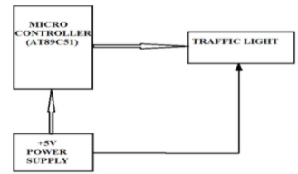
Block Diagram

Slide 6
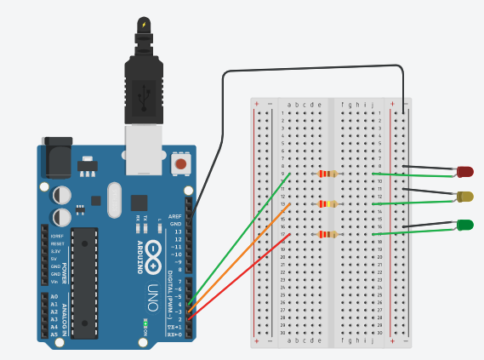
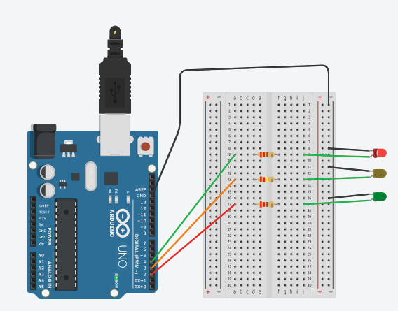
Project Images

Slide 7
Project Code
void setup()
{
pinMode(4, OUTPUT);
pinMode(3, OUTPUT);
pinMode(2, OUTPUT);
}
void loop()
{
digitalWrite(4, HIGH); // For red LED
delay(15000); // Wait for 15 second
digitalWrite(4, LOW);
digitalWrite(3, HIGH); // For yellow LED
delay(5000); // Wait for 5 second
digitalWrite(3, LOW);
digitalWrite(2, HIGH); // For the green LED
delay(15000); // Wait for 15 second
digitalWrite(2, LOW);
}

Slide 8
Applications
1. Ramp metering
2. Timer
3.Fire station or medical emergency entrance
4.At the entrance and exit of some car washes
5. At the landing stage of a ferry and abroad the ferry

Slide 9
Tinkercad Project link
https://www.tinkercad.com/things/bCSYKJk0RYF-traffic-light-dld-project/editel

Slide 10
Any Question?

Slide 11
Thank you

